Slide 1

Enumerable, LINQ
And (mostly) everything in-between

Slide 2
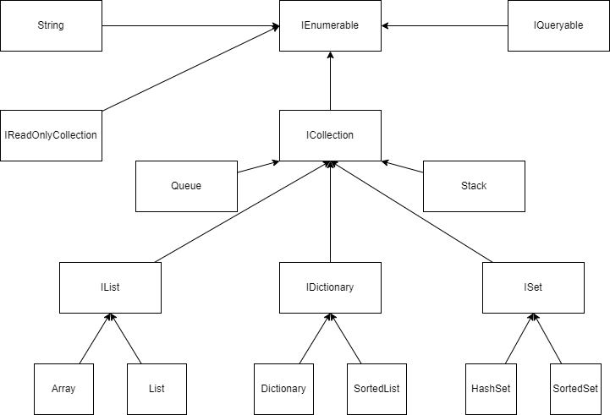
Full list

Slide 3
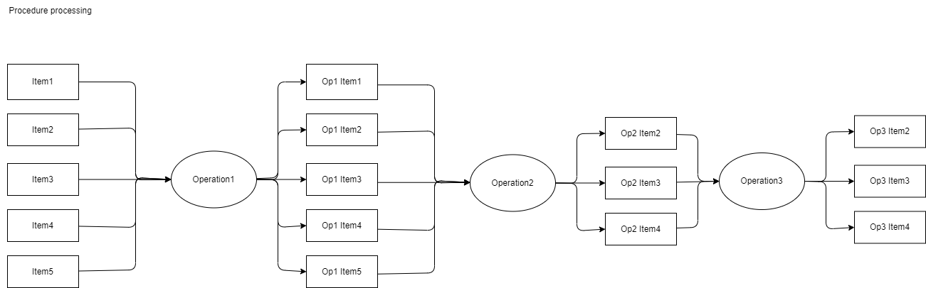

Slide 4
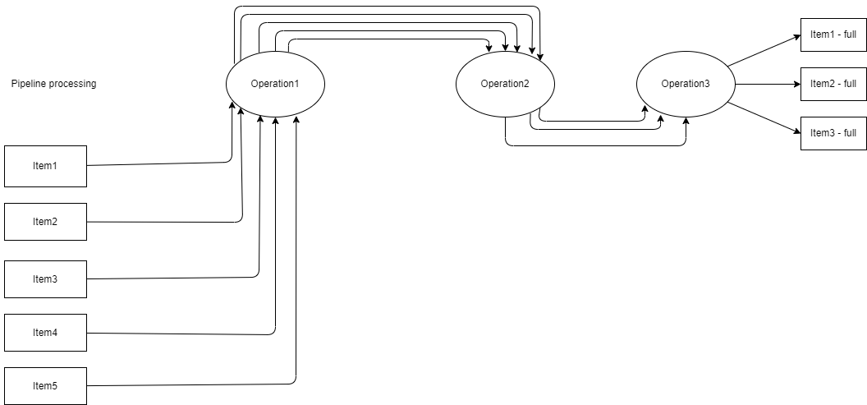

Slide 5
A few notes about pipeline processing
2 main types of operations:
Link operations:
Where, Select, Skip, Take
Collect operations:
ToXYZ – ToList / ToArray / ToSet / etc…
Sort / GroupBy / Count
Lazy / Deffered execution:
Nothing is executed until we apply a “collect” operation

Slide 6
Demo

Slide 7
Lets see our neighbors
Java
Stream
https://docs.oracle.com/javase/8/docs/api/java/util/stream/Stream.html
.stream()
A stream can be collected only once
Javascript
Typescript generators - https://www.typescriptlang.org/docs/handbook/iterators-and-generators.html
Lodash Operators
RxJs

